Slide 1
Art^2
David Castro, Marie Chu, Becky Miller, and Leyth Toubassy

Slide 2
“Learn Art and Build your Community – One pixel at a time”

Slide 3
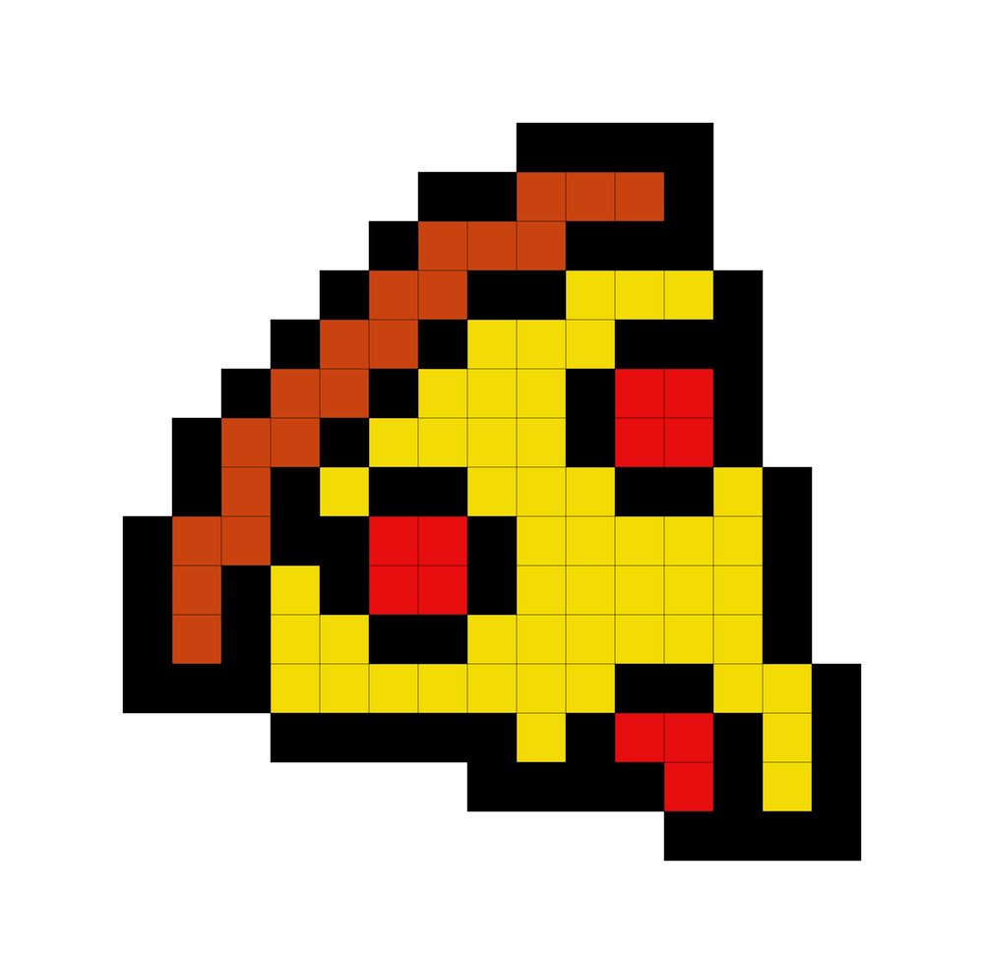
Problem
Solution
People don’t continue art after formal education because it is time consuming and they aren’t good it. This makes them hesitant to share their work with others since they’re not proud of their art.
App that allows users to learn an artistic medium with a lower barrier to entry (pixel art) and collaborate with others to build a community.

Slide 4
Roadmap
1. Concept Sketches
2-3. Realizations
4. Task Flows
5. Storyboards
6-7. Testing
8. Discussion

Slide 5
Concept Sketches

Slide 6
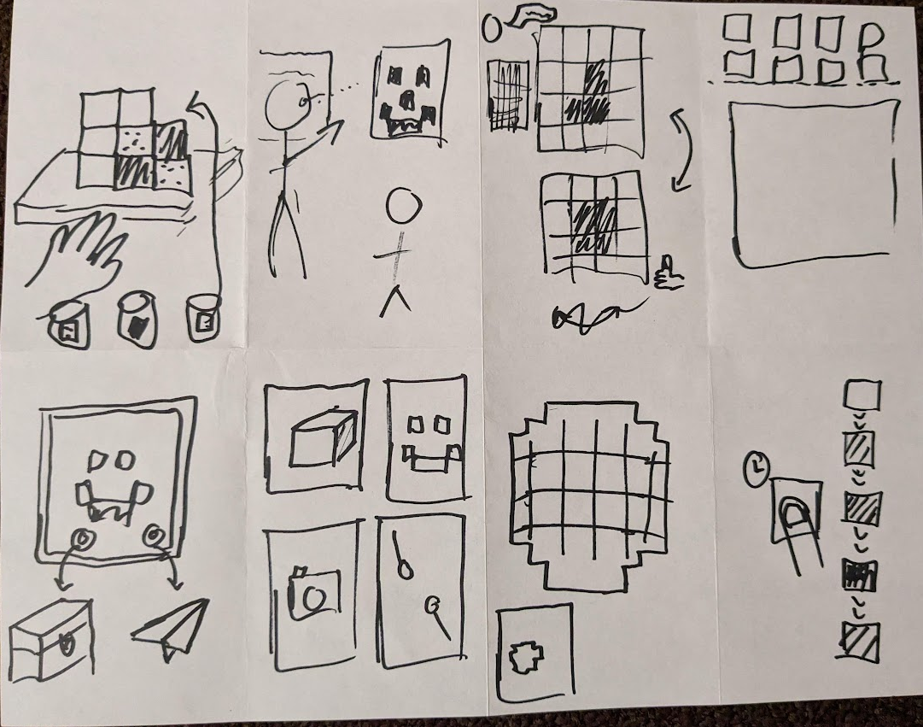
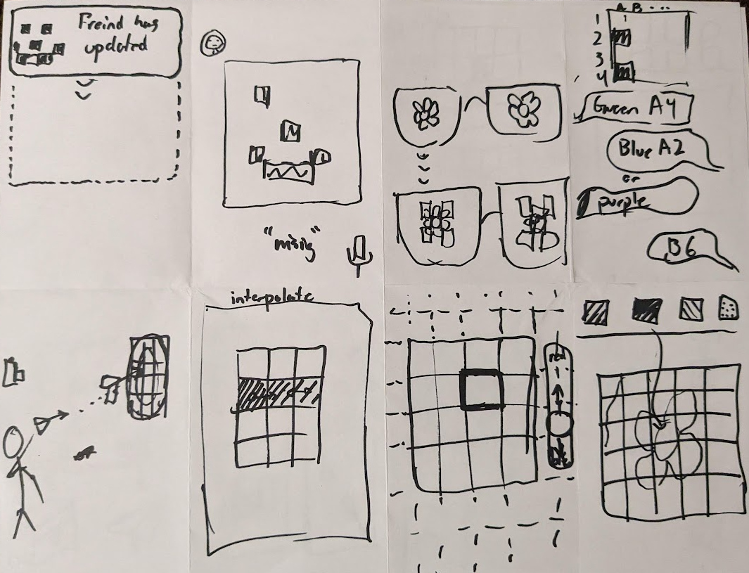

Slide 7
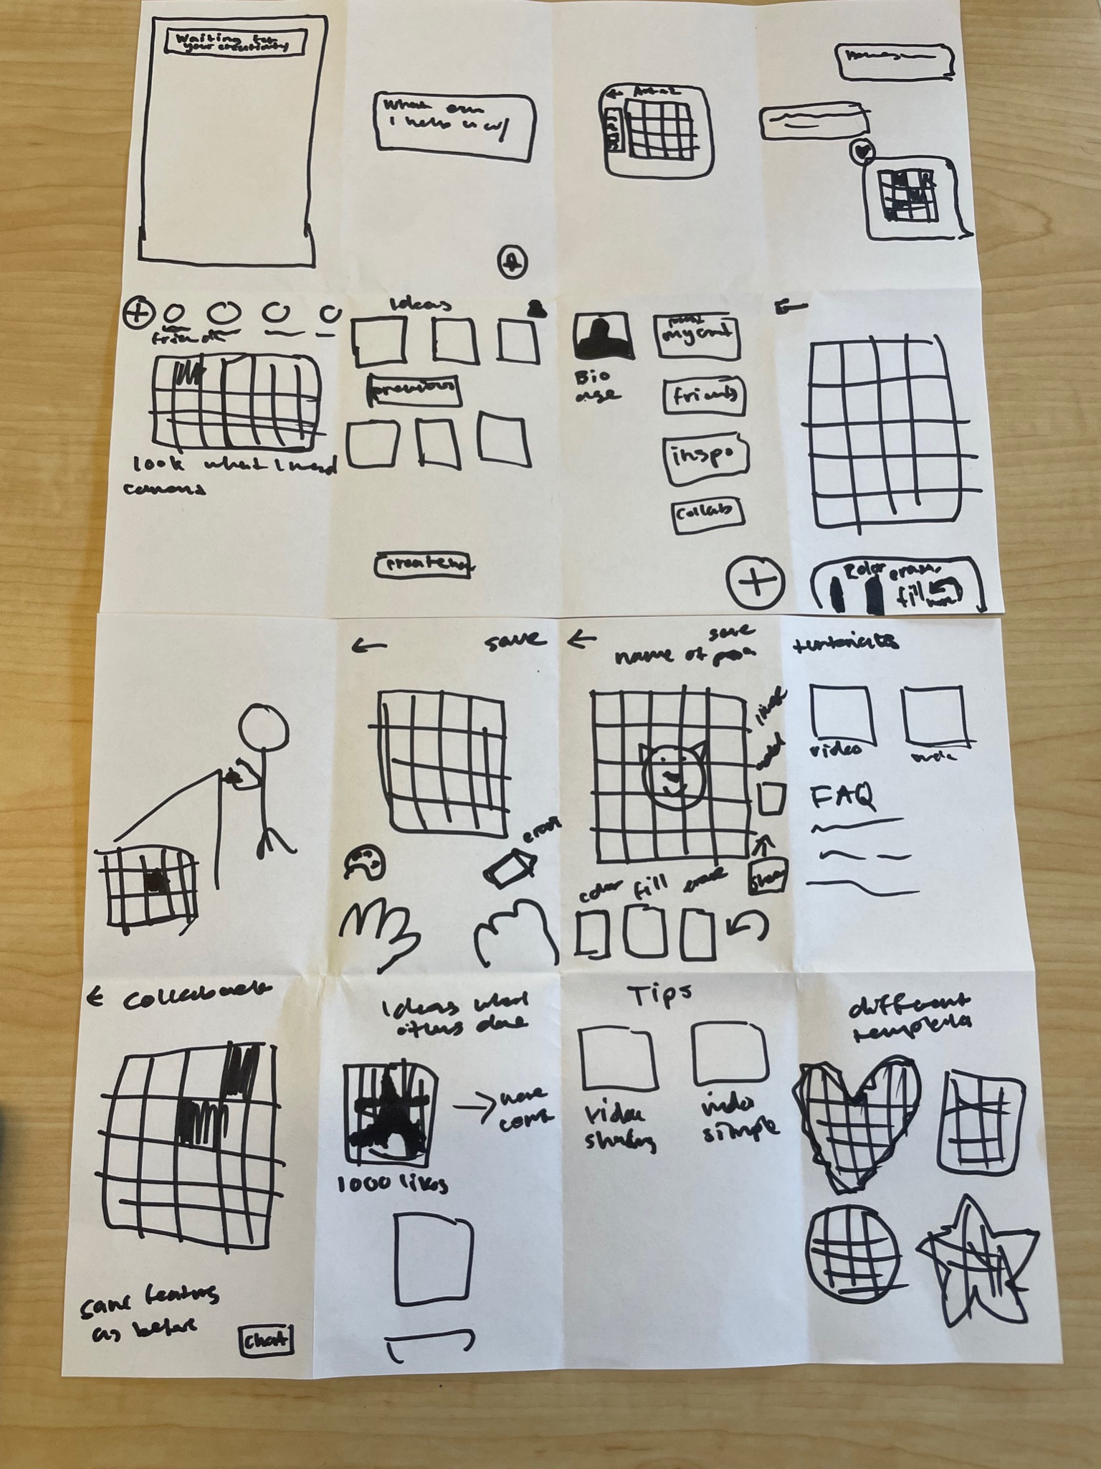
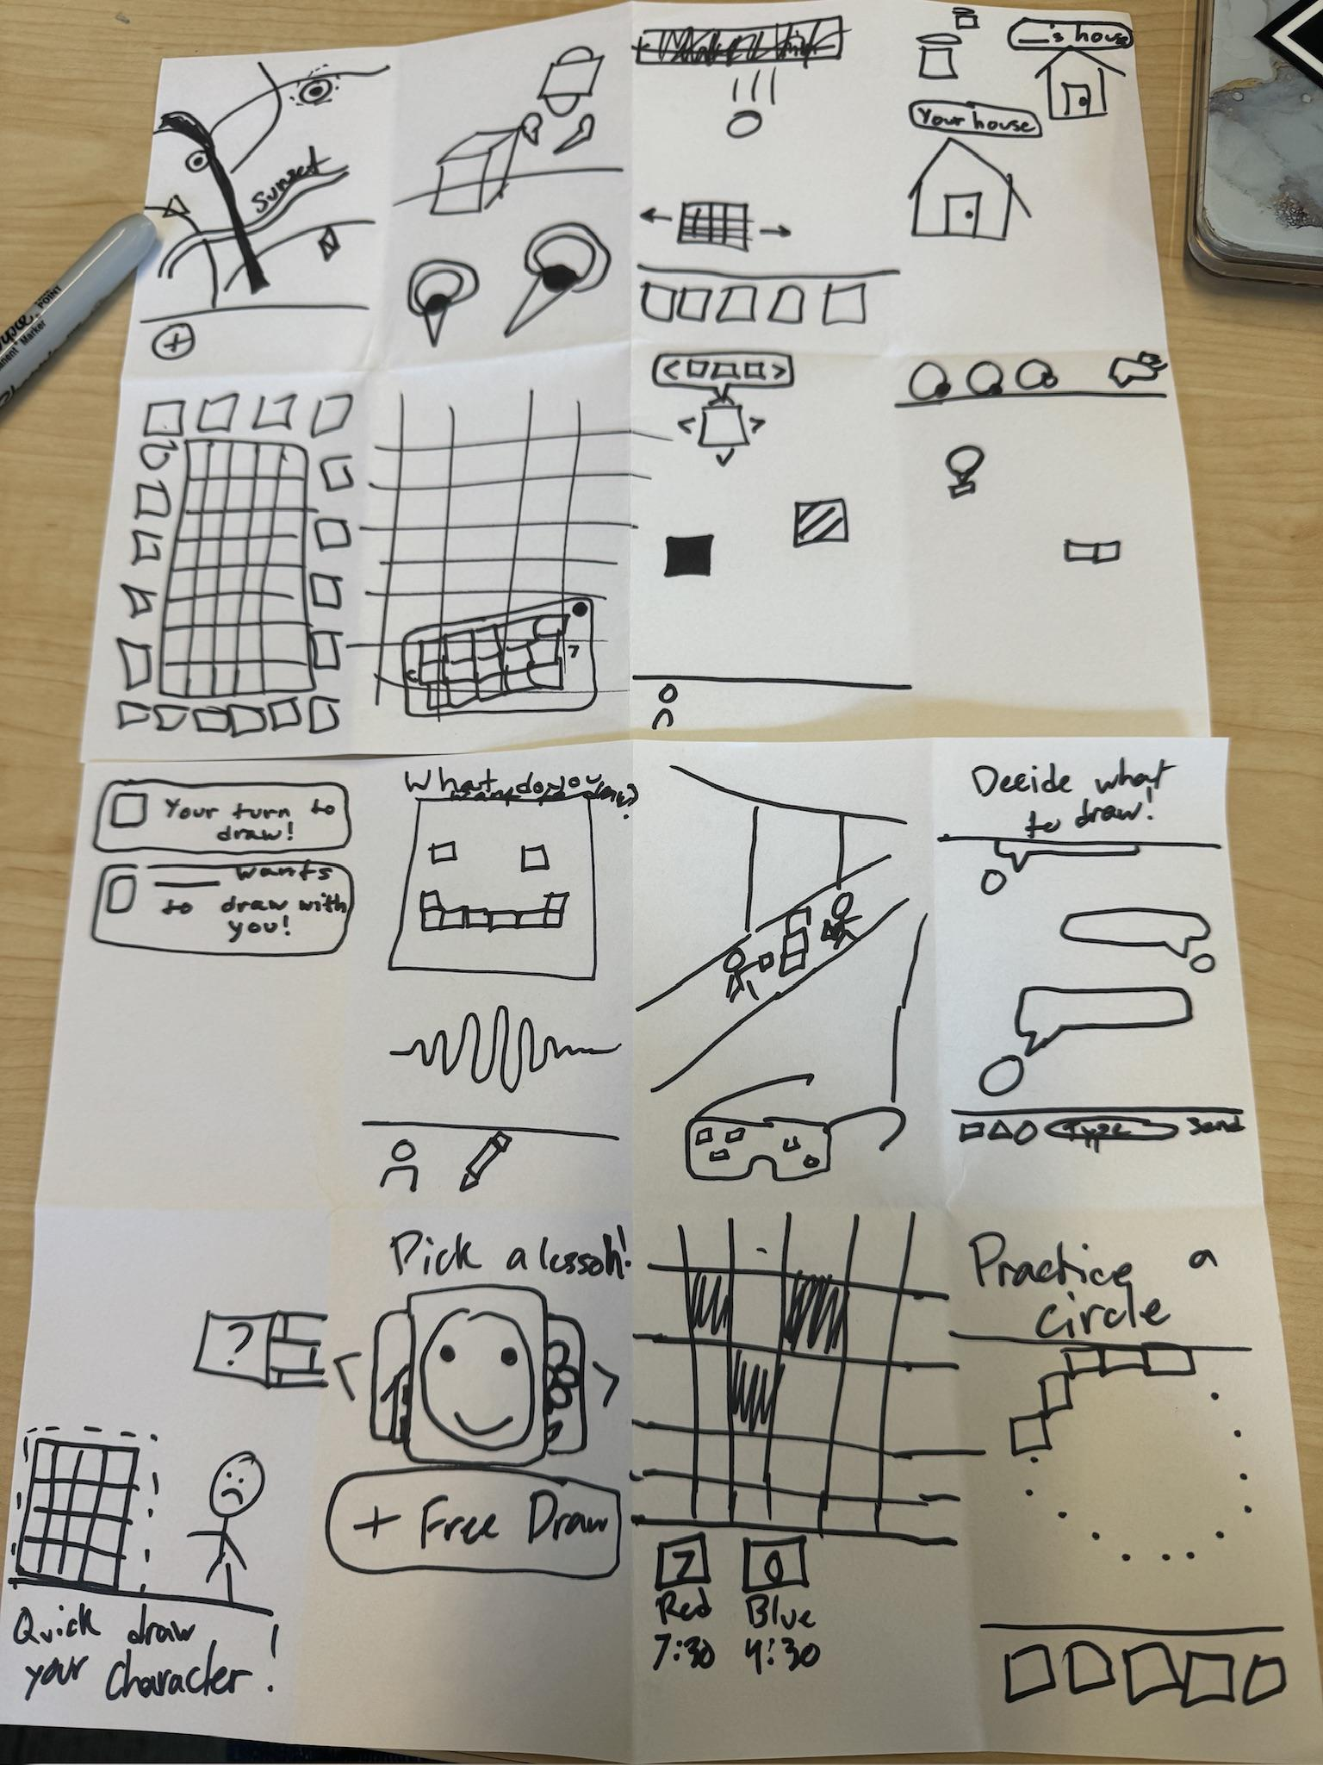
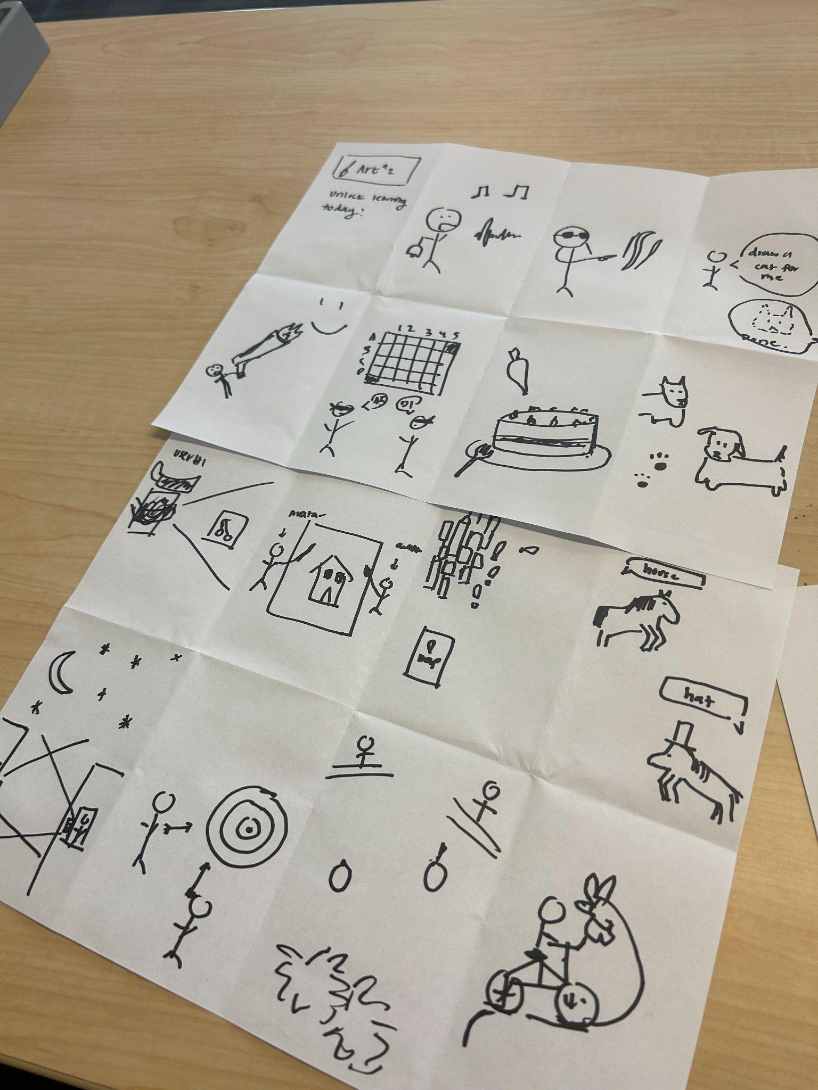

Slide 8
2&3. Realizations

Slide 9
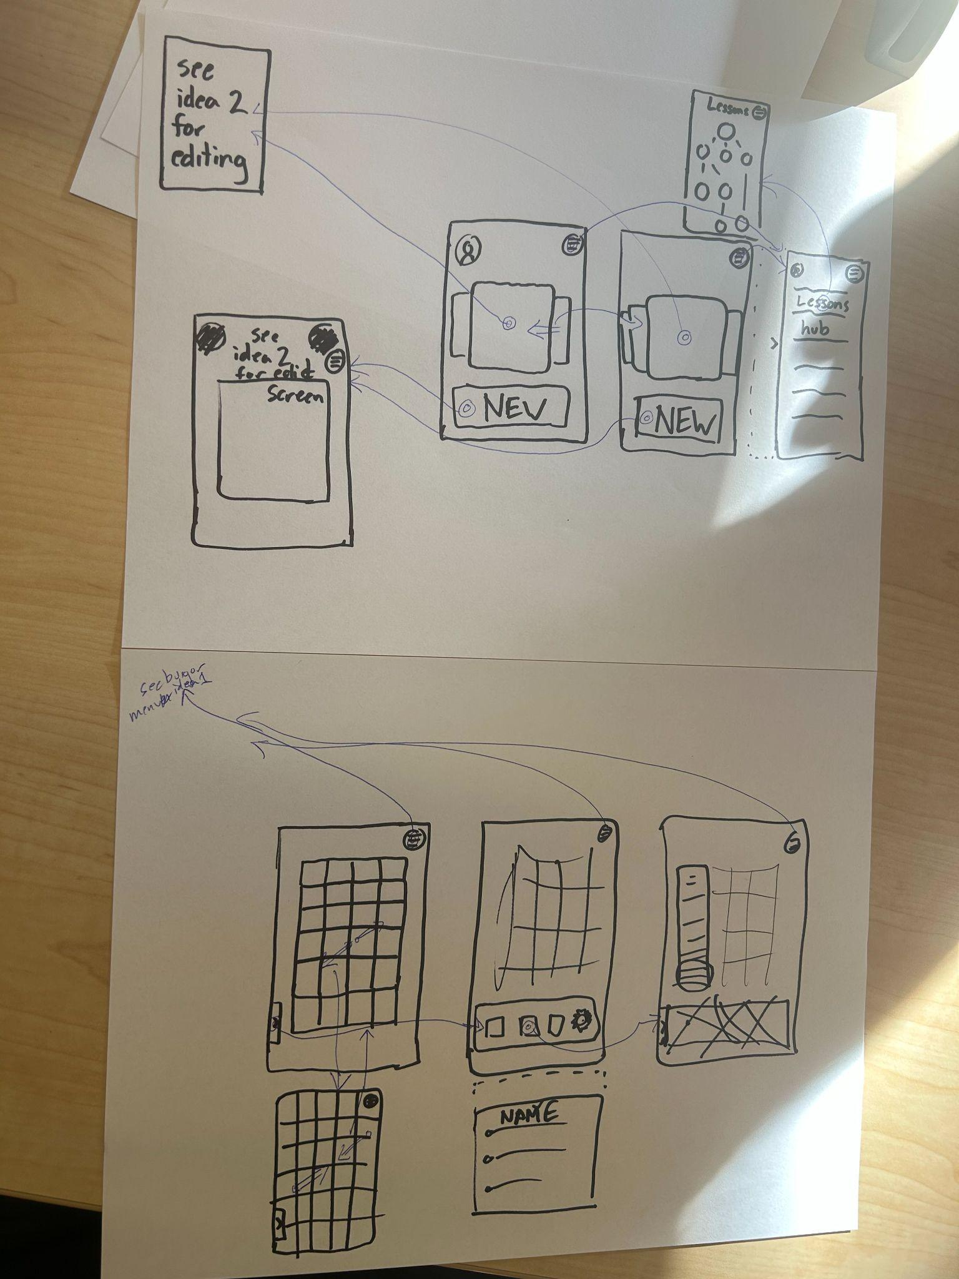
Realization One
Pros:
Only requires phone
Can use it on the go (i.e. in noisy environments)
Faster for the general population (tap versus voice)
Cons:
Not as accessible for those with loss of motor control in fingers
Smaller “real estate” due to screen size
Less immersive

Slide 10
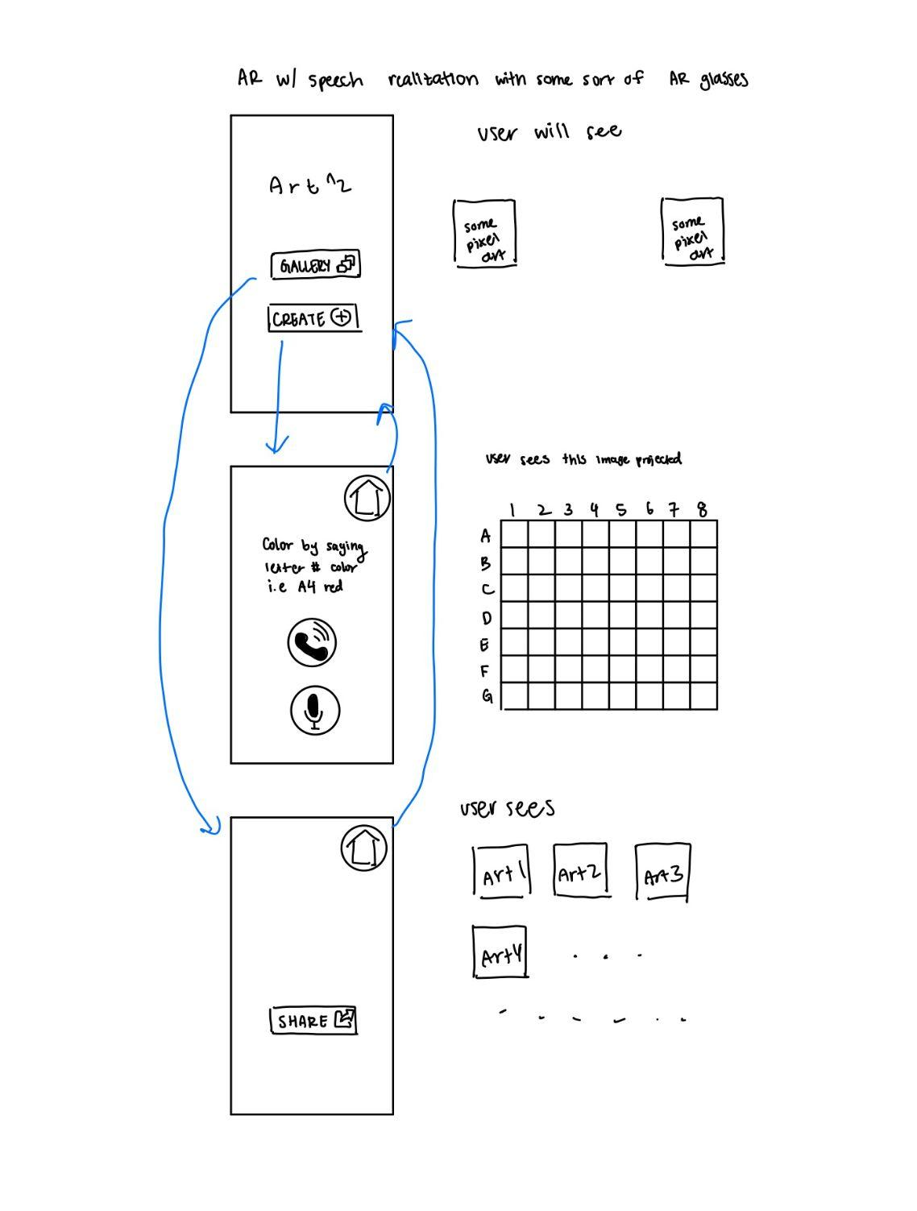
Realization Two
Pros:
Simple
Accessible for those with motor control issues
More “real estate” (can project pixel creation grid into the real world)
More immersive experience
Cons:
Doesn’t allow users to choose specific shades of color
Needs additional AR accessories
Cannot use app in noisy environments
Difficult for those with speech impediments

Slide 11
Choice: realization one

Slide 12
4. Lofi-Prototype

Slide 13
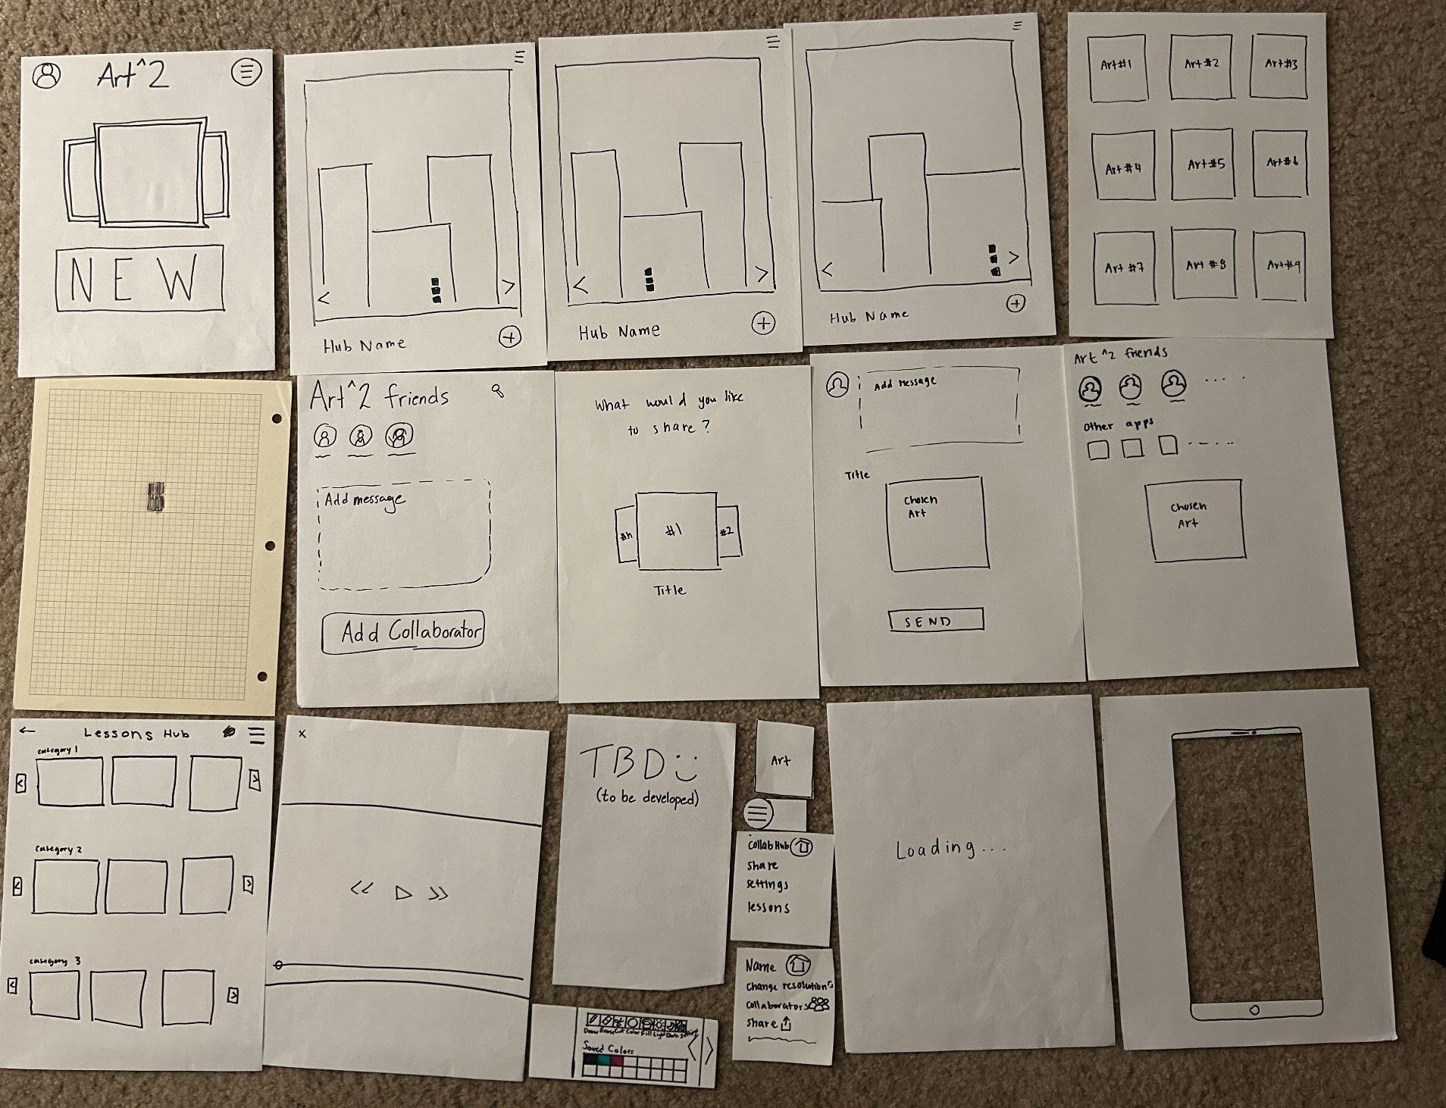
Lofi-prototype Construction
Built with paper
One screen per page
Main screens:
Home
Drawing Canvas
Lessons
Gallery Hub

Slide 14
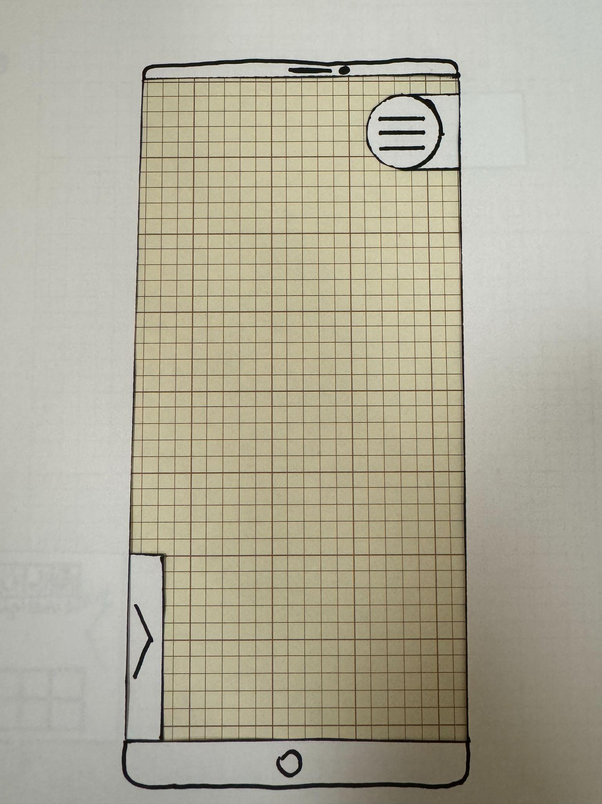
Lofi Prototype Challenge
How do we make a pixel art drawing app out of paper?
Graph Paper and a Pen!
Our drawing screen acted as an overlay for a piece of graph paper, so out participants could actually draw.

Slide 15
5. Task Flows

Slide 16
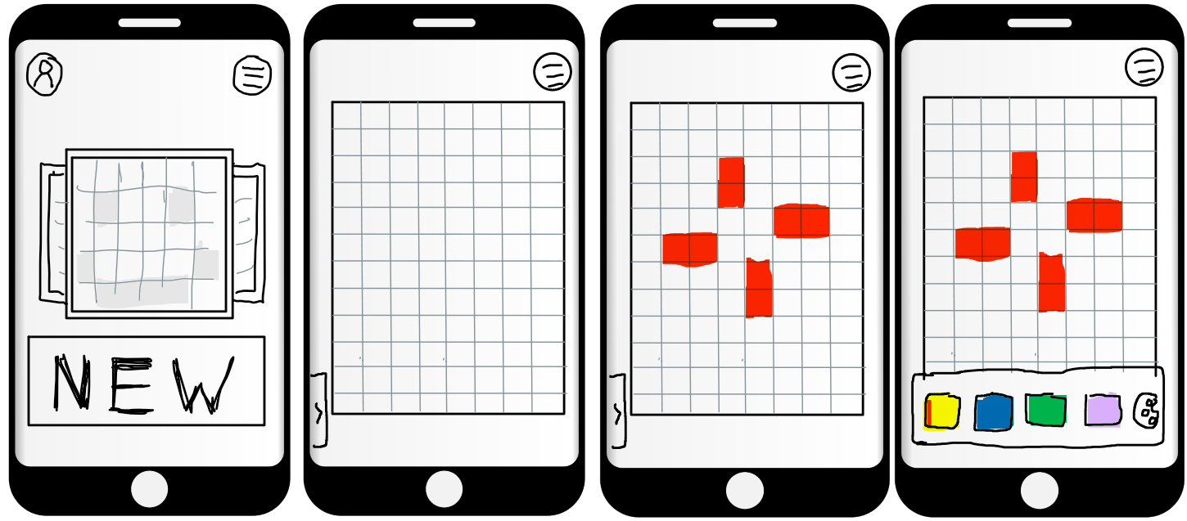
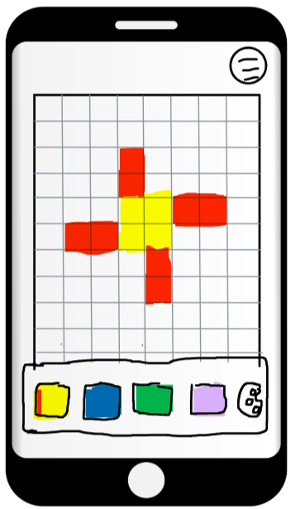
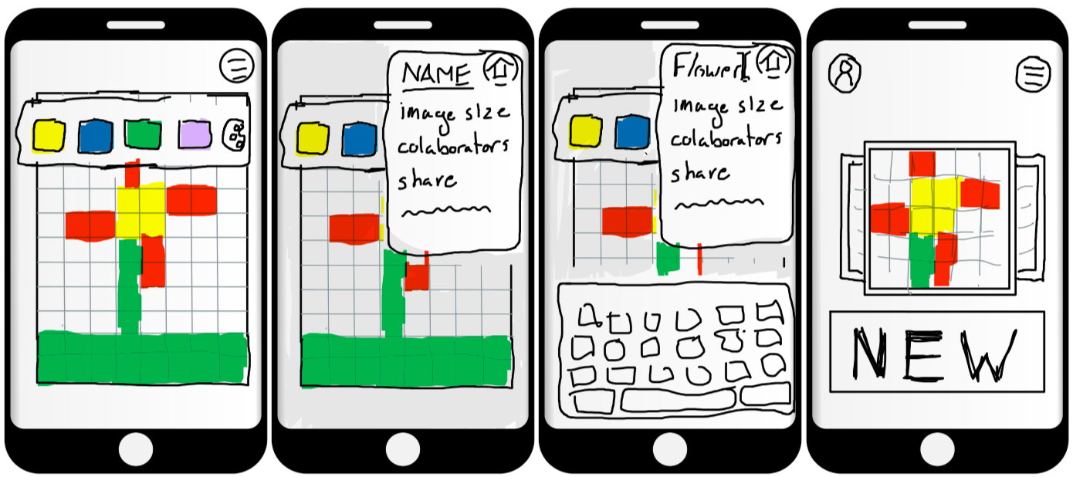
Task #1:
Create a Piece

Slide 17
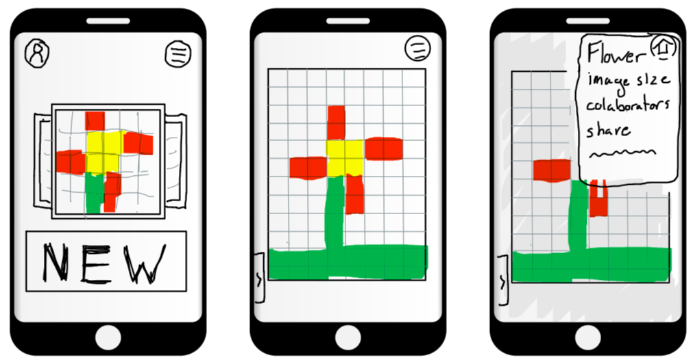
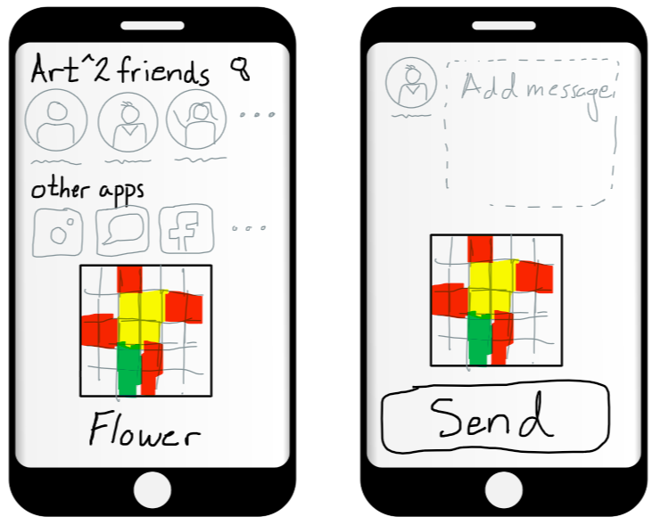
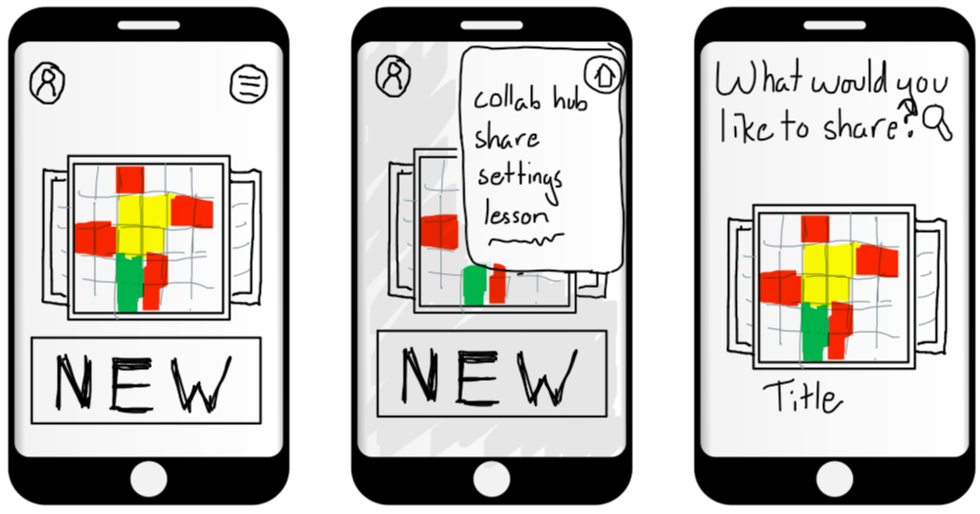
Task #2:
Share Your Work

Slide 18
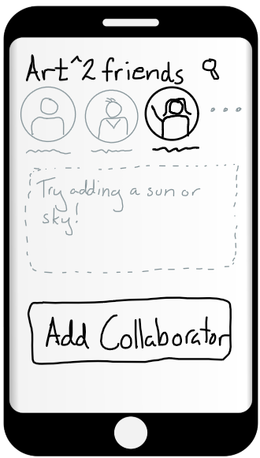
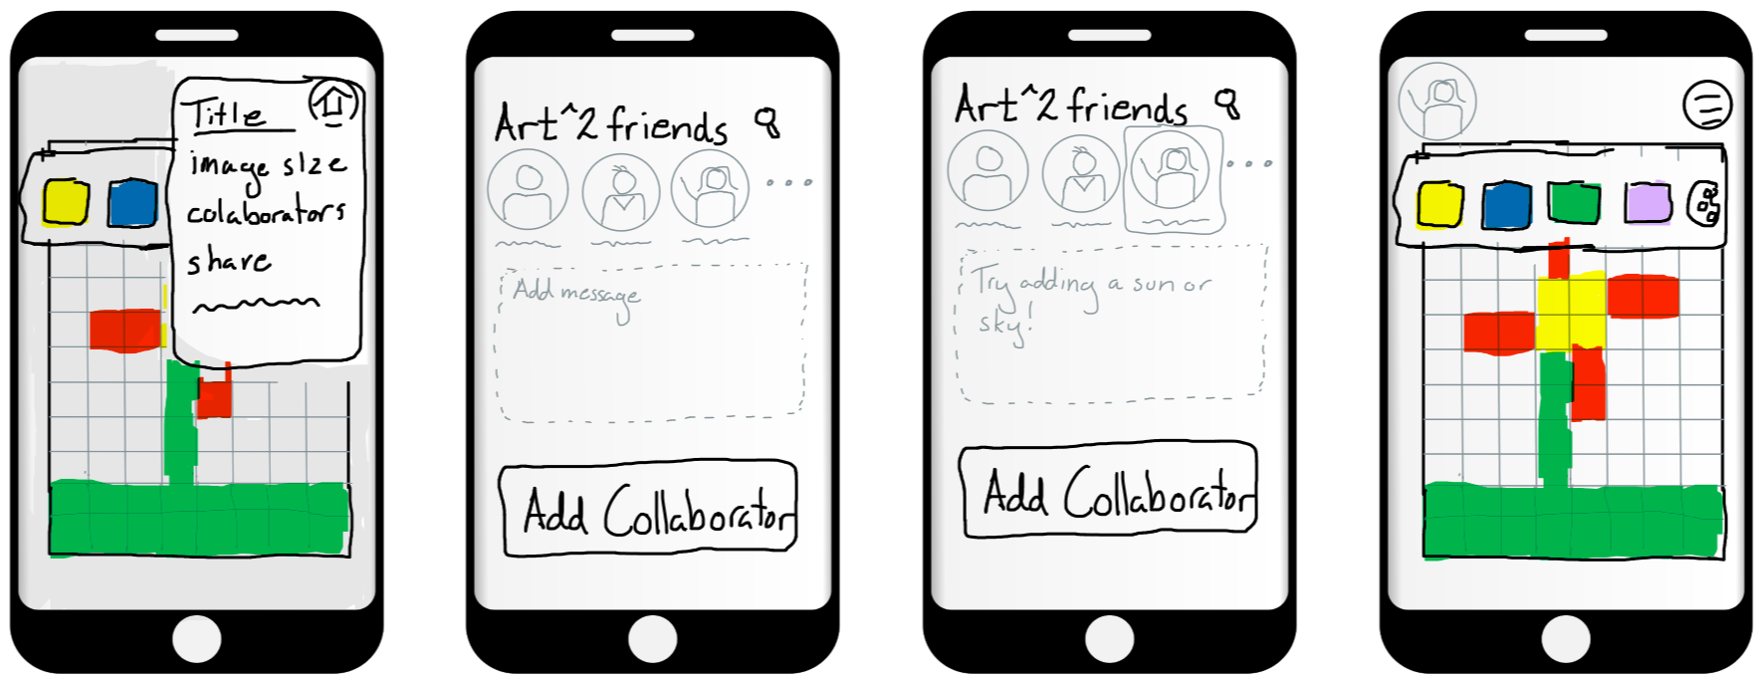
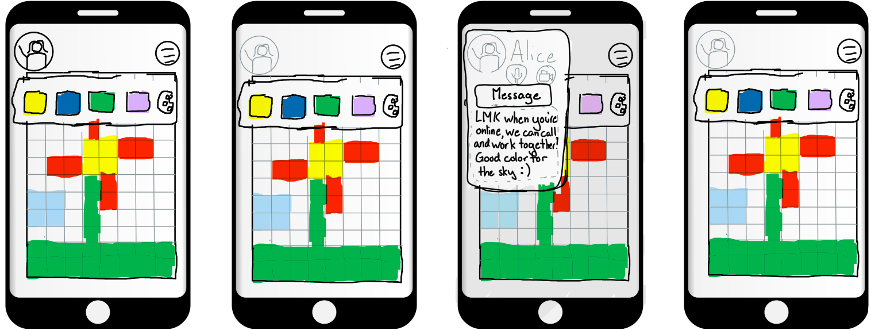
Task #3:
Collaborate
Notes:
Some notes in case this slide is confusing: the collaborators icon is usually greyed out, but goes black when they are active on the app. When they are active, the voice and video chat options are also active, and you can collaborate while on a audio or video call. You can send them a message at any time. I didn’t storyboard what the other person’s side looks like, but I can if we want

Slide 19
6&7. Testing

Slide 20
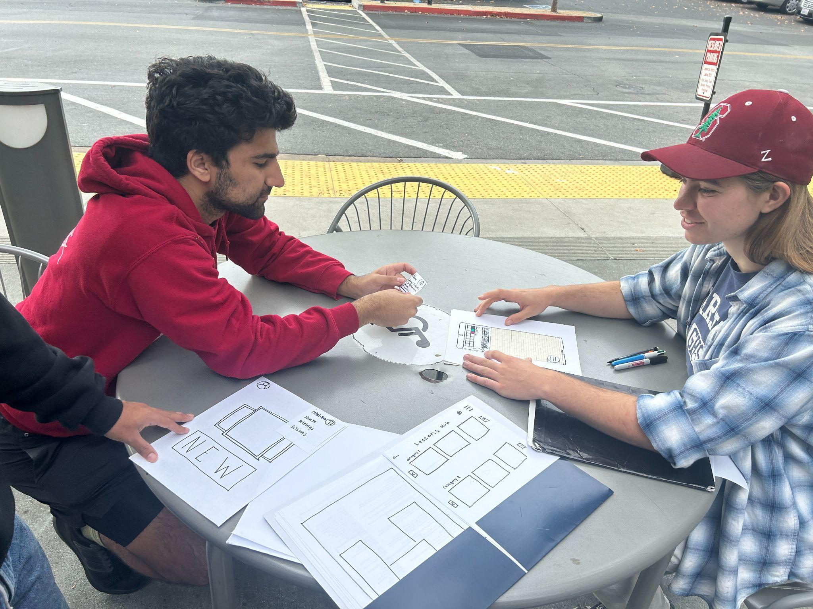
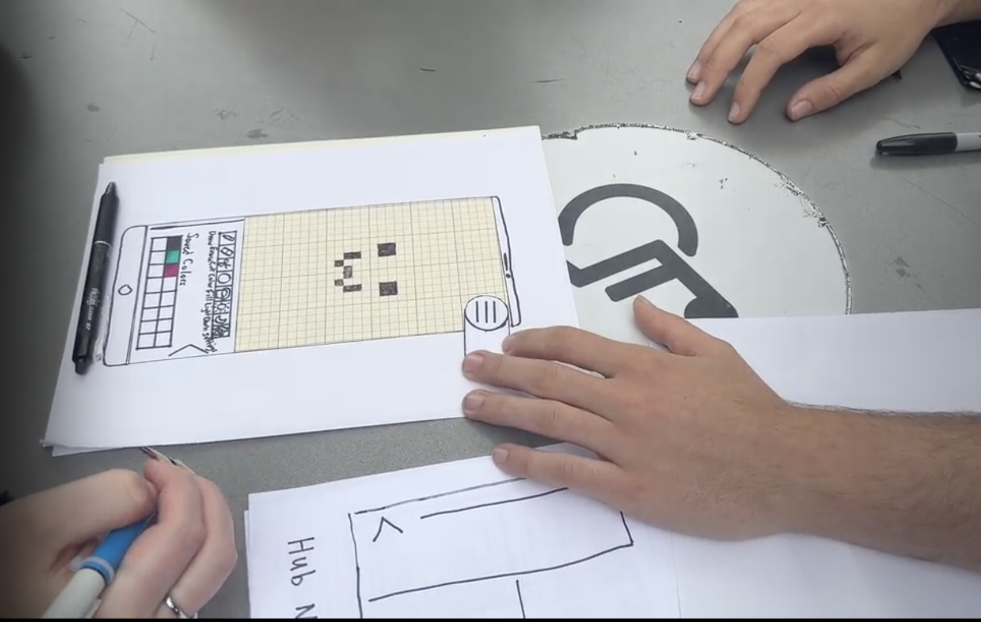
Testing Methodology
Participant Demographics:
2 in Finance
Non-college Adult
Founder of two startups
Recruitment:
Greeter asked individuals if they would be willing to assist Stanford students in testing an app idea
Environment
Outdoor seating area at Stanford Shopping Center
Apparatus
Lofi Paper Prototype
A pen
Tester Roles
Greeter: David, Facilitator: Leyth, Computer: Becky, Notetaker: Marie
Notes:
Since our solution has ended up being accessible to a far broader demographic than we originally intended, we wanted to test our solution with people outside of our

Slide 21
Test Procedure and Metrics
Give participants high level task descriptions
Make a drawing, share it, and add a collaborator
Participant Attitude
Generally Positive
Irrelevant buttons pressed
Generally not many
Time per task
A few seconds for all tasks

Slide 22
Testing Results (The Bad)
People care about customization
One user immediately wanted to change their avatar
Universal Icons are important
Two users remarked that the share button took longer to find because the universal symbol was not initially present
Non-main task items were confusing
In the gallery hub one user noted that “she had no idea what was going on” (might be clearer with actual pixel art in it

Slide 23
Testing Results (The Good)
Participants had fun
Said it was a good change of pace from the rest of their day
Main tasks were relatively easy
People like the ability to add friends
Easy to follow UI
Once users got to the main art screen, they were able to find menu options easily

Slide 24
8. Discussion

Slide 25
Findings
People enjoy the core product
Yay!
Home menu and iconography need some clarification
The task flows were intuitive to users, but they couldn’t always find the buttons they wanted, even if they existed
Toolbar may be too robust
Many of the tools have very specific use cases, and would not be necessary for most users
Features outside the drawing
Profile customization for the app, social features

Slide 26
What couldn’t we test?
Collaboration
We were able to test the collaboration menu, but not collaboration itself
Use of user drawing on other UI elements
We couldn’t add user drawings to the UI
Lessons
Again, we were able to test the lesson menu, but not the actual lessons themselves

Slide 27
Appendix

Slide 28
Realization One
Pros:
Only requires phone
More features
More aesthetically pleasing app
Can use it on the go (i.e. in noisy environments)
Faster for the general population (tap versus voice)
Allows user to customize resolution of pixel art, choose specific colors, etc.
Cons:
Not as accessible for those with loss of motor control in fingers
Smaller “real estate” due to screen size
Less immersive

Slide 29
Realization Two
Pros:
Simple
Accessible for those with motor control issues
Easier for those with vision impairments
More “real estate” (can project pixel creation grid into the real world
Allows user to see the “whole picture”
More immersive experience
Cons:
Too simple
Doesn’t allow users to choose specific shades of color
Needs additional AR accessories
Cannot use app in noisy environments
Difficult for those with speech impediments

Slide 30
Lofi Prototype (all screens)
https://drive.google.com/drive/folders/1-24Z7r6oKbHY5xR3KF6wPZNwu95mtXXK?usp=drive_link

Slide 31
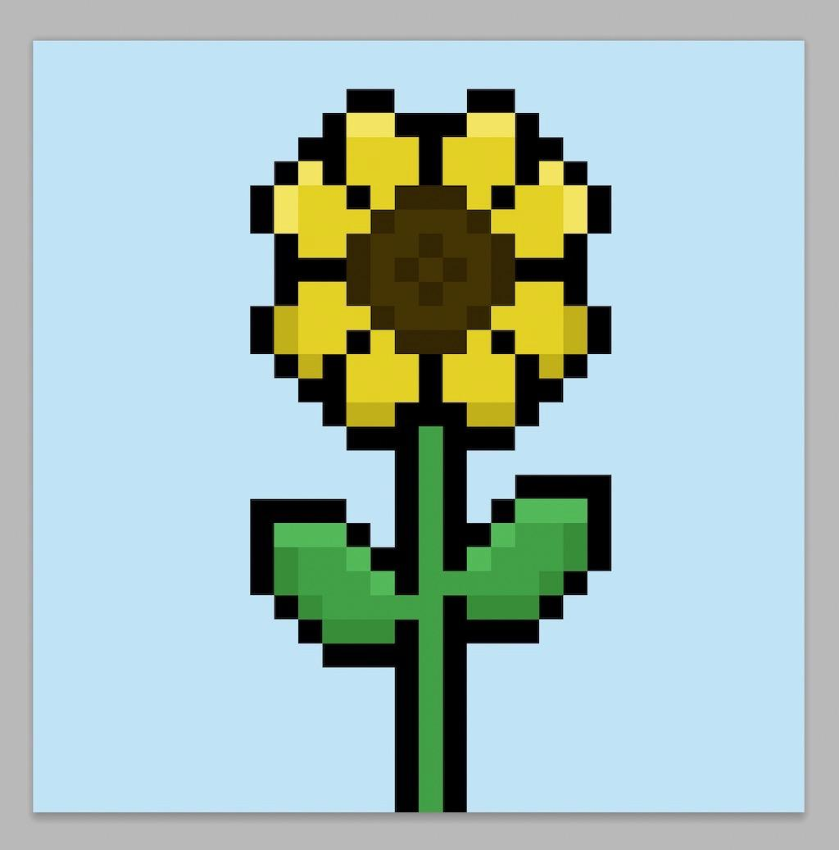
Script
We’re trying to design an application for individuals to learn and express their creativity in art through pixel art. Here’s a picture of pixel art (image below) if you’re not familiar with it. We designed a paper prototype of our application that we wanted to test out with users first before building our application. you can interact with it by tapping , scrolling, etc just like you would on a normal phone. We had 3 tasks we wanted to test out and want you to use our prototype to achieve that task, speaking out loud as you perform the actions.

Slide 32
Log of critical incidents
Participant #1
(2) Initially confused how he was supposed to draw (was trying to grab a pen)
(3) Drew normally instead of doing pixel art
(1) Couldn’t find share button at first
Participant #2
(2) Frustration over lack of supported features (i.e. avatar customization)
(4) Frustration over lack of clarity in gallery hub “I have no idea what’s going on
(2) Initially felt apologetic for not being good at art
(0) Afterwards enjoyment of creating pixel art
(1) Initially confused by the “title” on share selected art page
Participant #3
(1) Didn’t realize he was looking at a “home” screen for the app
(1) Couldn’t find share button
Participant #4
(2) Initially confused how he was supposed to draw (was trying to grab a pen)
(0) When asked to “share” he immediately clicked the menu button saying “I’m assuming it’s somewhere standard like here”
(0) Immediately found collab flow also

